Slide 1

AEROYNAMICS STUDY OF VERTICAL AXIS WIND TURBINE
AND PERFORMANCE PREDICTION
DEPARTMENT OF AEROSPACE ENGINEERING
Student:
Mai Nguyễn Văn
Assoc. Prof. Nguyễn Thiện Tống
Dr. Lê Thị Hồng Hiếu
Instructors:
January 2018

Slide 2
OUTLINE
PROBLEM STATEMENT
OBJECTIVES OF THE THESIS
AERODYNAMICS MODEL
RESULTS VALIDATION
DESIGN APPLICATION
CONCLUSIONS

Slide 3
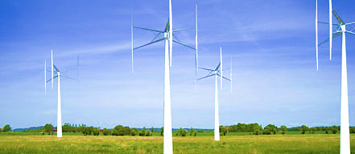
1. PROBLEM STATEMENT
IMPORTANCE OF VAWT POWER PREDICTION AND APPLICATION
Another factor that plays an equally important role in determining the economic viability of such Darrieus machines is their expected lifetime
Aerodynamics analysis described above is relatively straightforward and can provide quantitative results that are useful for optimization of
VAWT geometry operating tip speed ratio, blade profile, rotor solidity and aspect ratio.
The model may also be used to estimate the forces on the blades which can then form the input to structural analysis and optimization of the rotor
Major aim for any generating system is to produce electricity for the lowest possible cost per unit of energy

Slide 4
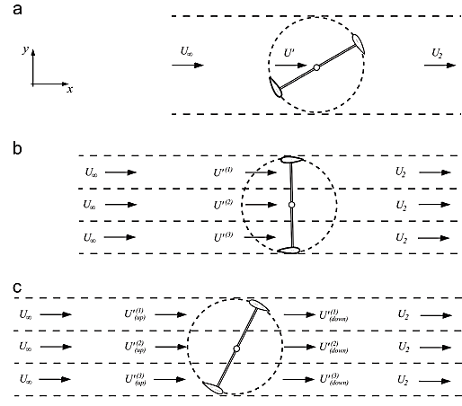
2. OBJECTIVES OF THE THESIS
Study the aerodynamics of straight blade VAWT by using and combining Blade element theory with momentum theory to determine solidity and power coefficient versus tip speed ratio.
Three prediction model will be introduced and use to compare with each other.
Integrating Tip loss and Finite aspect ratio effect in the three models to improve the results

Slide 5
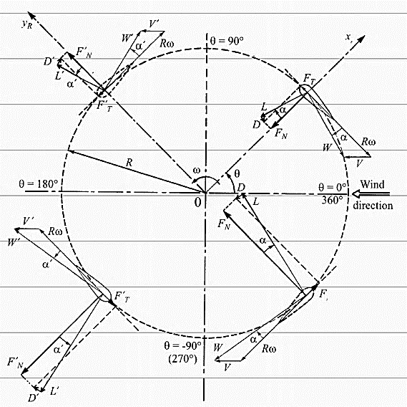
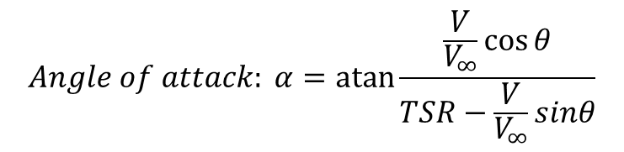
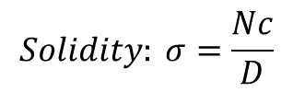
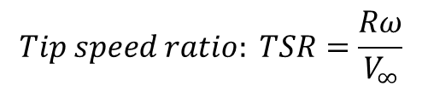
3. AERODYNAMICS MODEL
General aerodynamics and parameters of VAWT
$$Tip speed ratio: TSR=\frac{Rω}{V_{∞}}$$
$$Solidity: σ=\frac{Nc}{D}$$
$${Relative velocity: W}^{2}={\left(Rω−Vsinθ\right)}^{2}+{V^{2}cos}^{2}{θ}$$
$$Angle of attack: α=\operatorname{atan}{\frac{\frac{V}{V_{∞}}\cos{θ}}{TSR−\frac{V}{V_{∞}}sinθ}}$$
VAWT flow velocities and blade[1]
Notes:
[1] I. Paraschivoiu, Wind Turbine Design with empasis on Darrieus Concept. Polytechnic International Press, 2002.

Slide 6
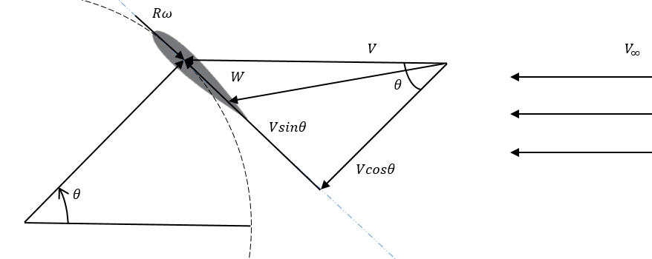
3. AERODYNAMICS MODEL
General aerodynamics and parameters of VAWT
$$Tip speed ratio: TSR=\frac{Rω}{V_{∞}}$$
$$Solidity: σ=\frac{Nc}{D}$$
$${Relative velocity: W}^{2}={\left(Rω−Vsinθ\right)}^{2}+{V^{2}cos}^{2}{θ}$$
Blade element velocity diagram
$$Angle of attack: α=\operatorname{atan}{\frac{\frac{V}{V_{∞}}\cos{θ}}{TSR−\frac{V}{V_{∞}}sinθ}}$$
Notes:
[1] I. Paraschivoiu, Wind Turbine Design with empasis on Darrieus Concept. Polytechnic International Press, 2002.

Slide 7
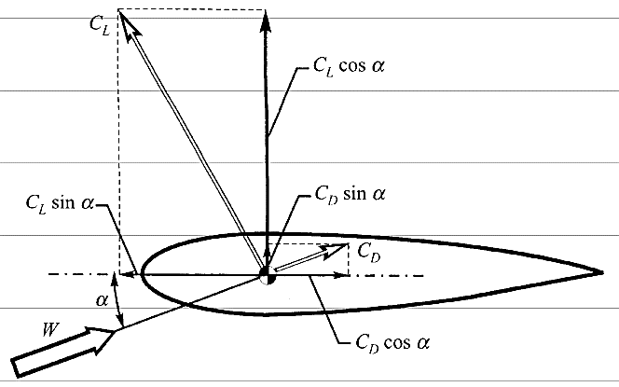
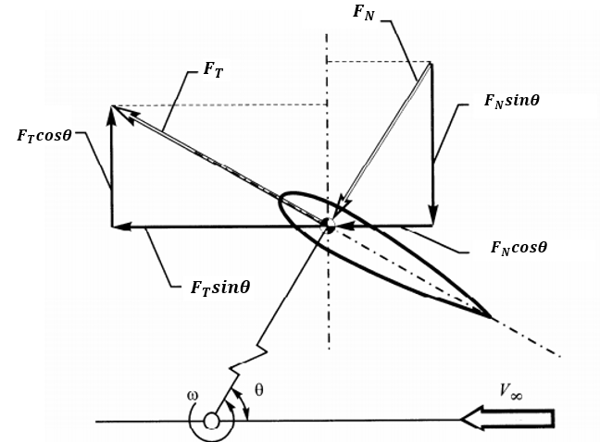
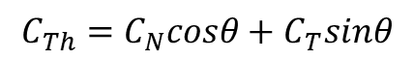
3. AERODYNAMICS MODEL
Blade Element Method
Force coefficients of a blade element airfoil[1]
Forces on a blade element airfoil in a horizontal plane[1]
$$Thrust\left(parallel to V_{∞}\right)=F_{N}cosθ+F_{T}sinθ$$
$$C_{Th}=C_{N}cosθ+C_{T}sinθ$$
Notes:
[1] I. Paraschivoiu, Wind Turbine Design with empasis on Darrieus Concept. Polytechnic International Press, 2002.

Slide 8
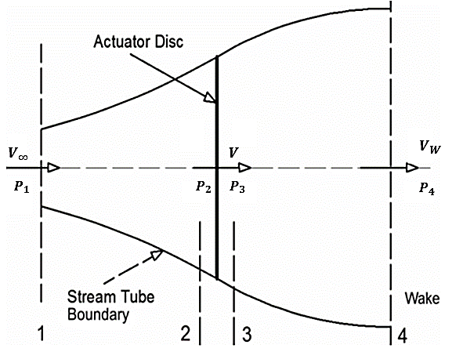
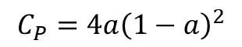
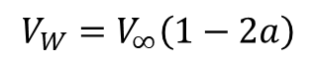
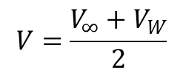
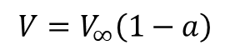
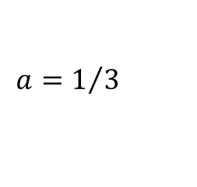
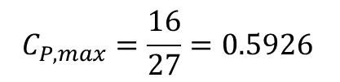
3. AERODYNAMICS MODEL
Momentum theory
A simple model, generally attributed to Betz (1926), can be used to determine the power from an ideal turbine rotor, the thrust of the wind on the ideal rotor, and the effect of the rotor operation on the local wind field
Conservation of linear momentum
Bernoulli function
Actuator disc model of a wind turbine[2]
$$V=\frac{V_{∞}+V_{W}}{2}$$
$$V=V_{∞}\left(1−a\right)$$
$$V_{W}=V_{∞}\left(1−2a\right)$$
$$C_{P,max}=\frac{16}{27}=0.5926$$
$$a=1/3$$
$$C_{P}=4a{\left(1−a\right)}^{2}$$
Notes:
[2] M. A. Biadgo, A. Simonović, D. Komarov, and S. Stupar, “Numerical and analytical investigation of vertical axis wind turbine,” FME Trans., vol. 41, no. 1, pp. 49–58

Slide 9
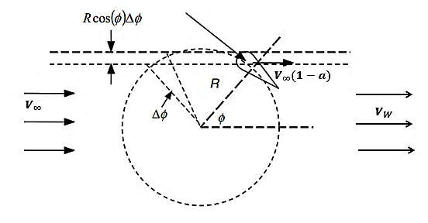
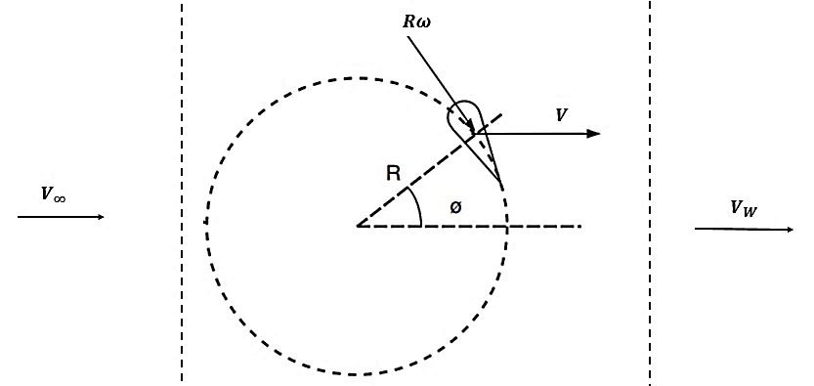
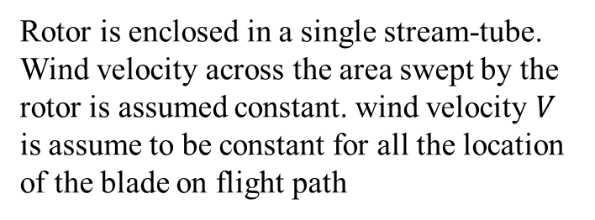
3. AERODYNAMICS MODEL
Streamtube models
Multiple streamtube geometry [3]
Velocities diagram [3]
Rotor is enclosed in a single stream-tube. Wind velocity across the area swept by the rotor is assumed constant. wind velocity $V$ is assume to be constant for all the location of the blade on flight path
In this approach it is assumed that the induction factor may vary in the direction perpendicular to the wind, but is constant in the direction of the wind.
Notes:
[3] J. F. Manwell, J. G. McGowan, and A. L. Rogers, Wind Energy Explained. 2009.

Slide 10
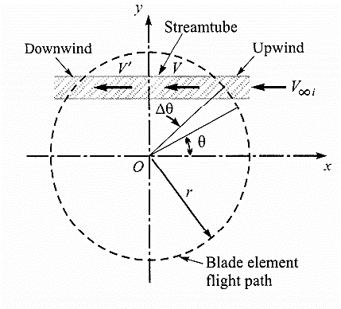
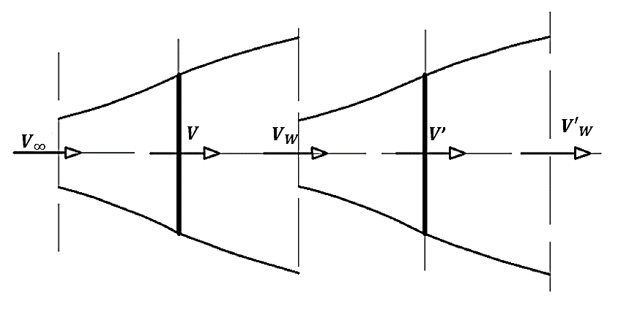
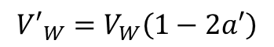
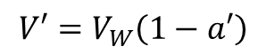
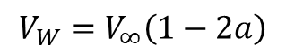
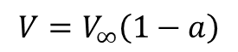
3. AERODYNAMICS MODEL
Streamtube models
A pair of actuator disks in tandem [2]
$$V=V_{∞}\left(1−a\right)$$
DMST model uses two induced factors in one stream tube [1]
$$V_{W}=V_{∞}\left(1−2a\right)$$
$$V′=V_{W}\left(1−a′\right)$$
$${V′}_{W}=V_{W}\left(1−2a′\right)$$

Slide 11
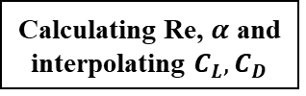
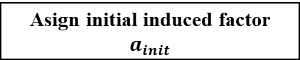
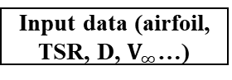
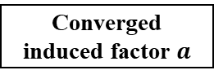
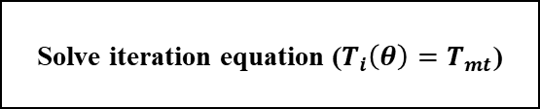
4. CALCULATION PROCESS
Star
Determining azimuthal angle
Input data (airfoil, TSR, D, $V_{∞}$…)
Asign initial induced factor $a_{init}$
Calculating Re, $α$ and interpolating $C_{L}, C_{D}$
Solve iteration equation ($T_{i}\left(θ\right)=T_{mt}$)
Convergence condition satisfied?
No
Yes
Converged induced factor $a$

Slide 12
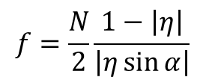
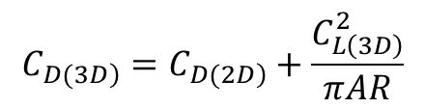
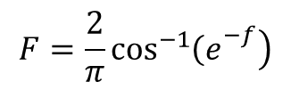
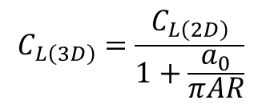
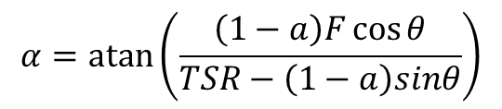
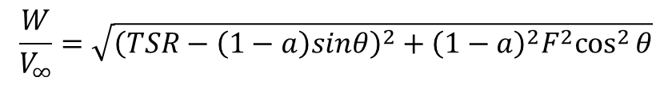
3. AERODYNAMICS MODEL
Finite aspect ratio effect
Straight blade wind turbine performance prediction is significantly affected by blade tips and finite aspect ratio effects
The air passing through the rotor flows toward the tips of the blade, and the streamtubes passing near the blade tips consequently transfer less momentum to the airfoil than those passing at the equator. The blade tips are consequently less efficient than the rest of the blade
$$F=\frac{2}{π}\cos^{−1}\left.{\left(e\right.}^{−f}\right)$$
$$f=\frac{N}{2}\frac{1−\left|η\right|}{\left|η\sin{α}\right|}$$
$$\frac{W}{V_{∞}}=\sqrt{{\left(TSR−\left(1−a\right)sinθ\right)}^{2}+{{\left(1−a\right)}^{2}F^{2}cos}^{2}{θ}}$$
$$α=\operatorname{atan}\left(\frac{\left(1−a\right)F\cos{θ}}{TSR−\left(1−a\right)sinθ}\right)$$
$$C_{L\left(3D\right)}=\frac{C_{L\left(2D\right)}}{1+\frac{a_{0}}{πAR}}$$
$$C_{\left.D(3D\right)}=C_{\left.D(2D\right)}+\frac{C_{L\left(3D\right)}^{2}}{πAR}$$

Slide 13
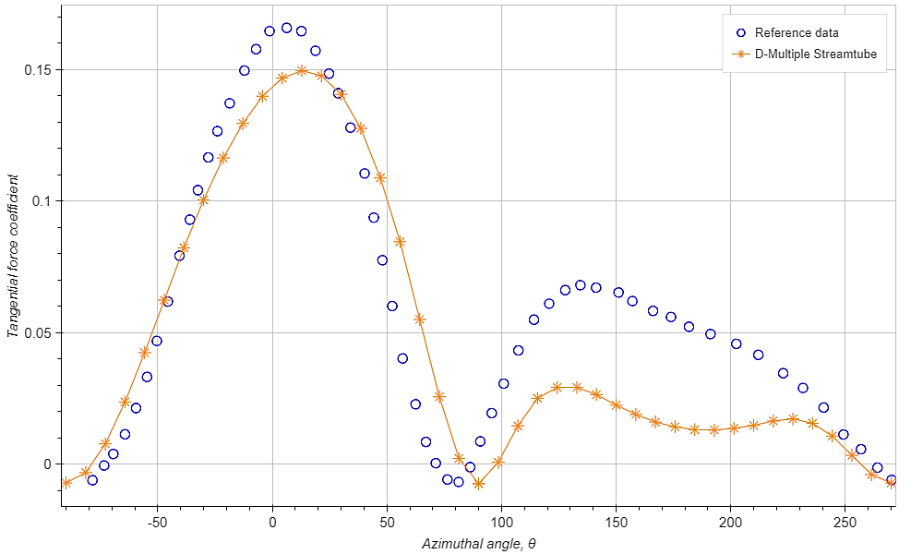
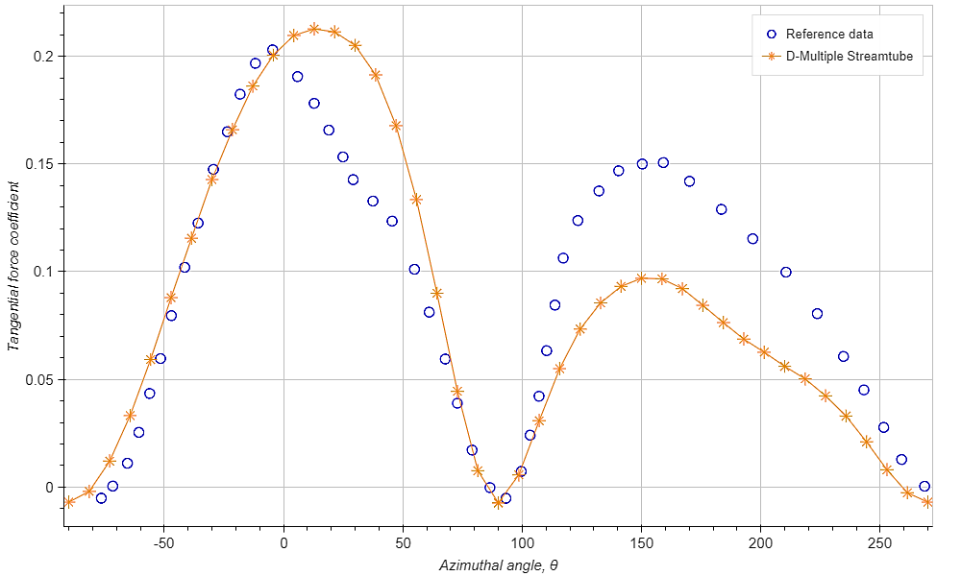
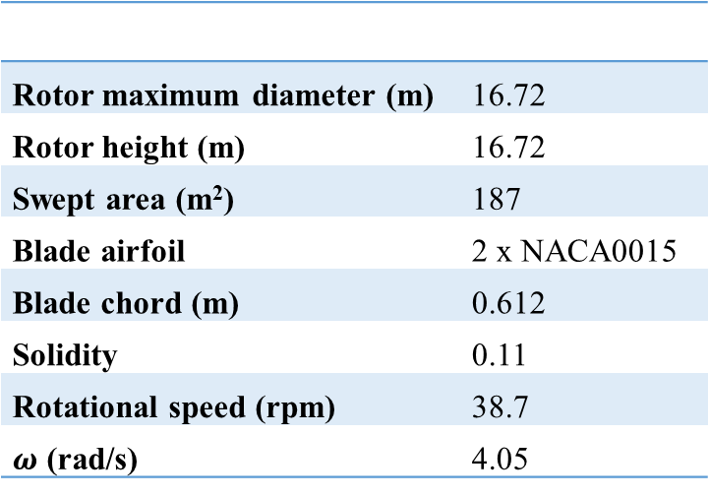
4. RESULTS VALIDATION
Comparison with Numerical simulation
Eduard Dyachuk (2015) in his thesis Development of Simulation Tools and Experiments
Sandia 17m VAWT [4]
Rotor maximum diameter (m) | 16.72
Rotor height (m) | 16.72
Swept area (m²) | 187
Blade airfoil | 2 x NACA0015
Blade chord (m) | 0.612
Solidity | 0.11
Rotational speed (rpm) | 38.7
$ω$ (rad/s) | 4.05
Tangential force coefficient from two calculation at $TSR=4.6$
There is a good agreement of the two tangential force graph in the upwind half of the rotor, while in the downwind half of the rotor, this thesis simulation under predict the force compared to the reference simulation data
Tangential force coefficient from two calculation at $TSR=3.7$
Notes:
[4]E. Dyachuk, “Aerodynamics of Vertical Axis Wind Turbines - Development of Simulation Tools and Experiments,” Acta Universitatis Upsaliensis, 2015.

Slide 14
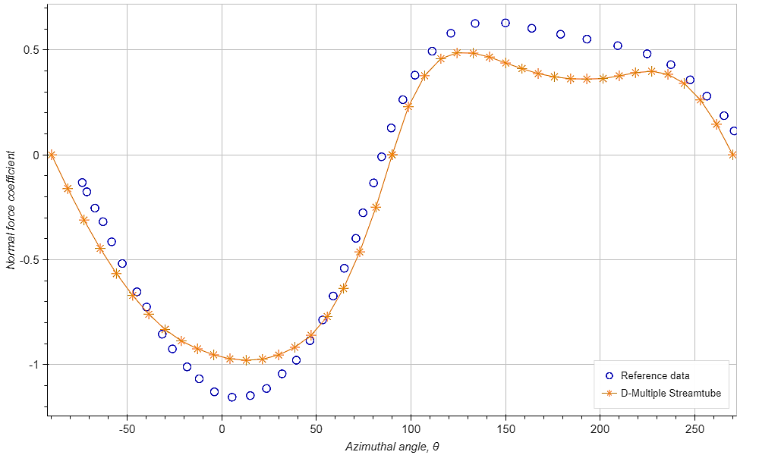
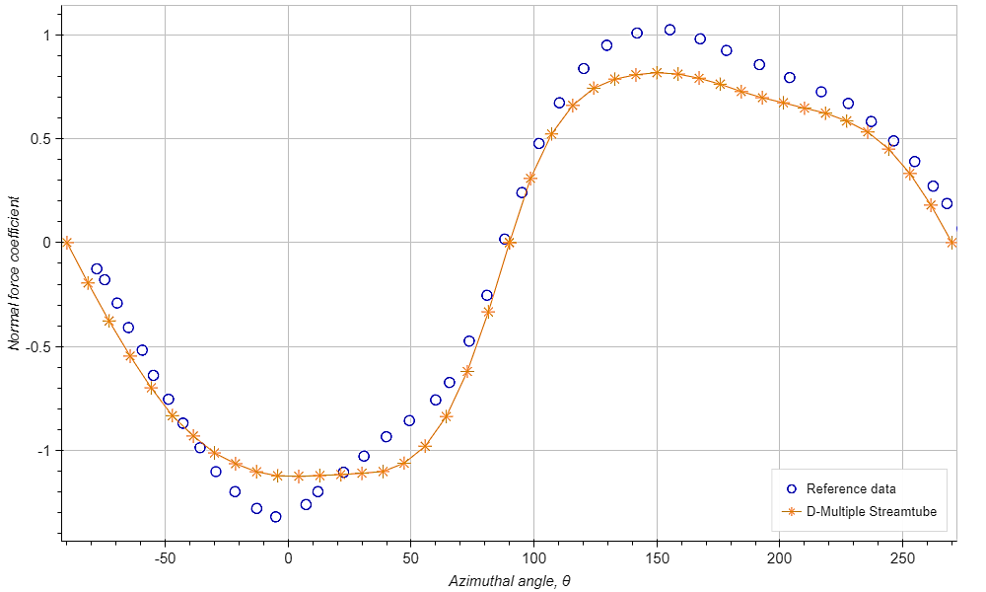
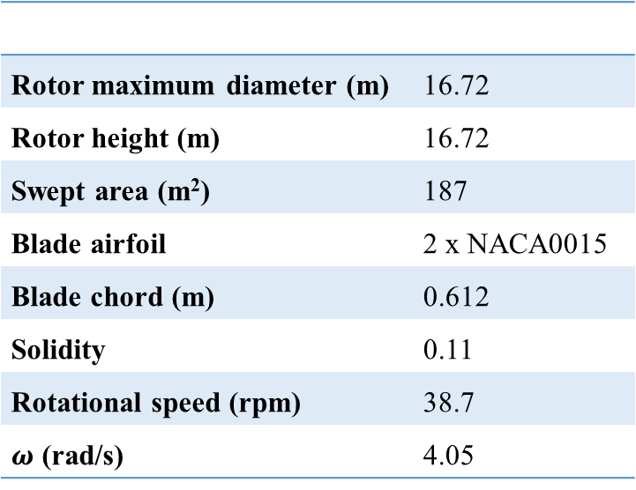
4. RESULTS VALIDATION
Comparison with Numerical simulation
Eduard Dyachuk (2015) in his thesis Development of Simulation Tools and Experiments
Sandia 17m VAWT [4]
Rotor maximum diameter (m) | 16.72
Rotor height (m) | 16.72
Swept area (m²) | 187
Blade airfoil | 2 x NACA0015
Blade chord (m) | 0.612
Solidity | 0.11
Rotational speed (rpm) | 38.7
$ω$ (rad/s) | 4.05
Normal force coefficient from two calculation at $TSR=4.6$
Normal force coefficient from two calculation at $TSR=3.7$

Slide 15
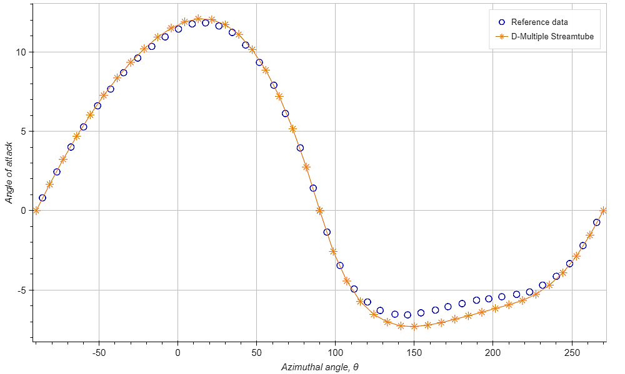
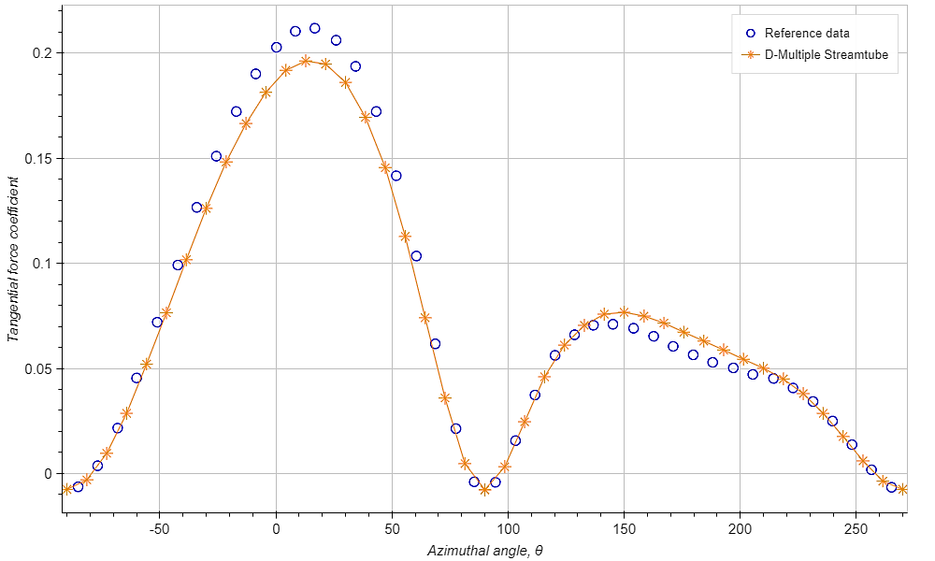
4. RESULTS VALIDATION
Comparison with Numerical simulation
L. H. Trong in his thesis in 2016: Development Of A Program For Designing Vertical Axis Wind Turbines
VAWT H-260 [5]
Rated power (kW) | 105
Rotational speed (rpm) | 33
Rated wind speed (m/s) | 10
Rotor diameter (m) | 19.5
Swept area (m²) | 260
Blade airfoil | 2 x NACA 0018
Blade chord (m) | 1.02
Solidity | 0.105
AR | 13
Local AOA from two calculation at $TSR=4$, $ω=33 RPM$
Tangential force coefficient from two calculation at $TSR=4$, $ω=33 RPM$
Notes:
[5] L. H. Trong, “Development Of A Program For Designing Vertical Axis Wind Turbines,” Vietnam National University Ho Chi Minh City University Of Technology, 2016.

Slide 16
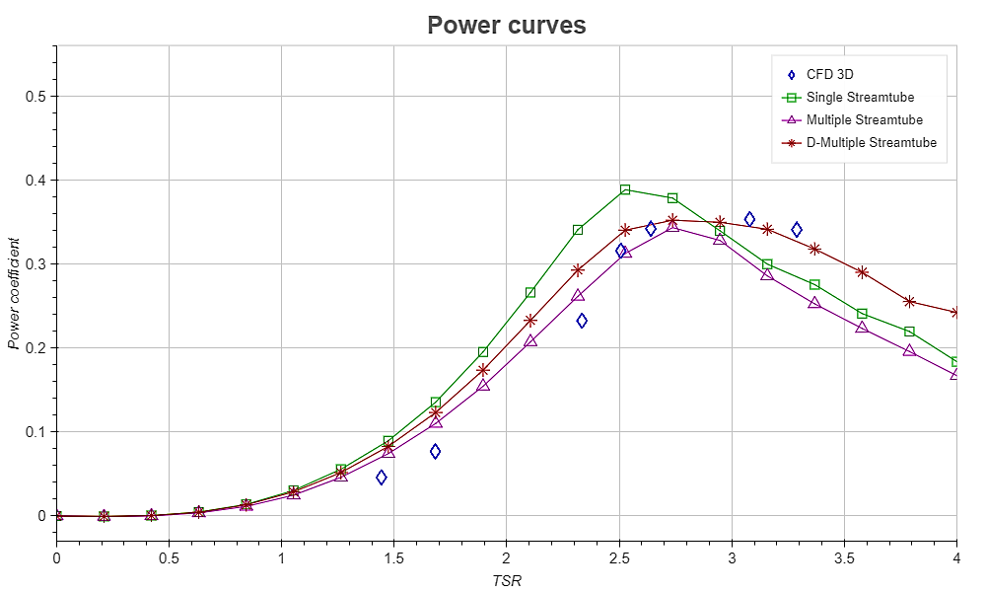
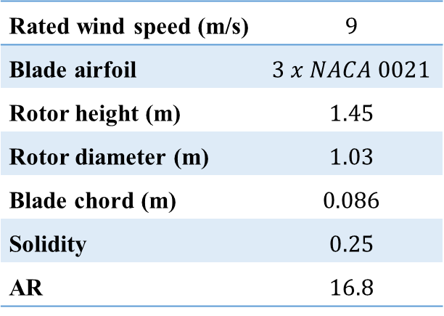
4. RESULTS VALIDATION
Comparison with CFD simulation
Abdolrahim Rezaeiha et al. did a work [7] on the Effect of pitch angle on power performance of a vertical axis wind turbine, in which he used 3D CFD model to prediction the performance of the same turbine
Three-bladed wind turbine model parameter [7]
Rated wind speed (m/s) | $$9$$
Blade airfoil | $$3 x NACA 0021$$
Rotor height (m) | $$1.45$$
Rotor diameter (m) | $$1.03$$
Blade chord (m) | $$0.086$$
Solidity | $$0.25$$
AR | $$16.8$$
Power curves comparison with CFD data
As TSR ranging from 1.5 to 2.5, all three model predict higher power coefficient. However, as TSR increase above 2.5, DMST yielded the best power curve with CFD data
Notes:
[7] A. Rezaeiha, I. Kalkman, and B. Blocken, “Effect of pitch angle on power performance and aerodynamics of a vertical axis wind turbine,” Appl. Energy, vol. 197, pp. 132–150, Jul. 2017.

Slide 17
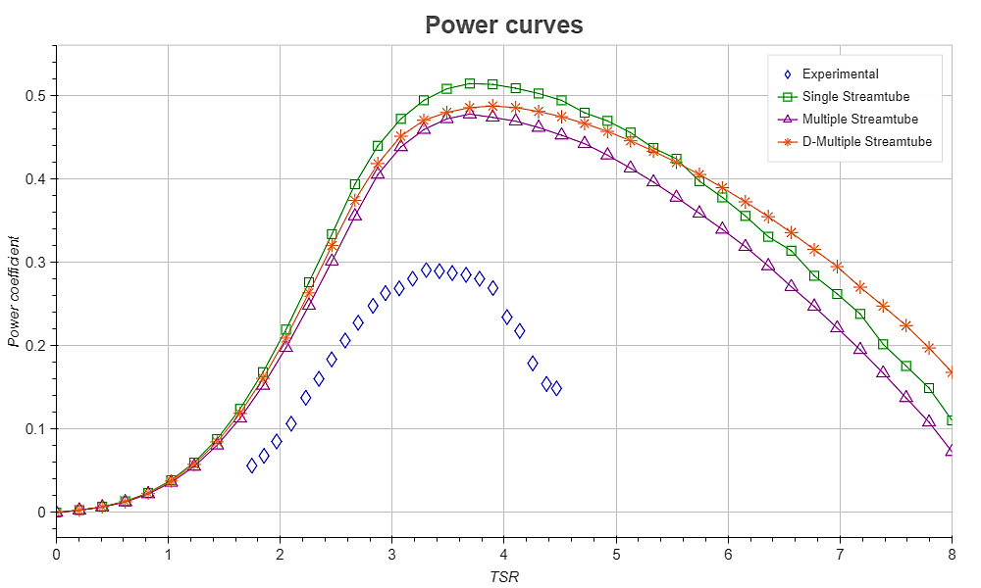
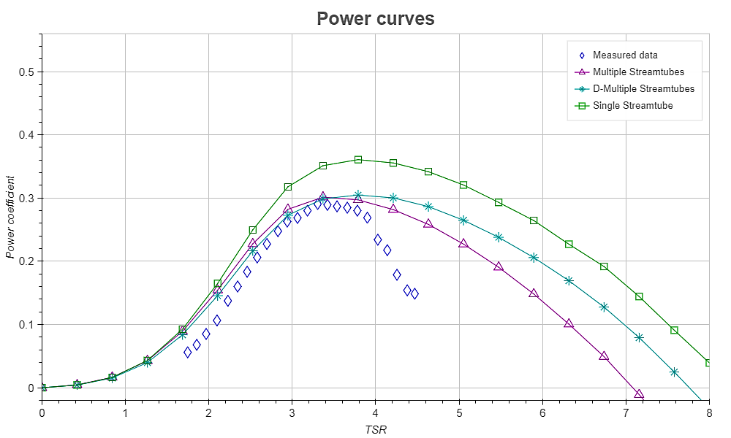
4. RESULTS VALIDATION
Comparison with Experimental data
J. Kjellin et al.published a paper in 2011 [8] about Power coefficient measurement on a 12 kW turbine
Uppsala University VAWT H-rotor [8]
Rated power (kW) | 12
Rotational speed (rpm) | 127
Rated wind speed (m/s) | 12
Rotor diameter (m) | 6
Swept area (m²) | 30
Blade airfoil | 3 x NACA 0021
Blade chord (m) | 0.25
Solidity | 0.116
AR | 20
Power curves of Uppsala University VAWT H-rotor
Power curves of Uppsala University VAWT H-rotor with finite AR effect
Notes:
[8] J. Kjellin, F. Bülow, S. Eriksson, P. Deglaire, M. Leijon, and H. Bernhoff, “Power coefficient measurement on a 12 kW straight bladed vertical axis wind turbine,” Renew. Energy, vol. 36, no. 11, pp. 3050–3053, Nov. 2011.

Slide 18
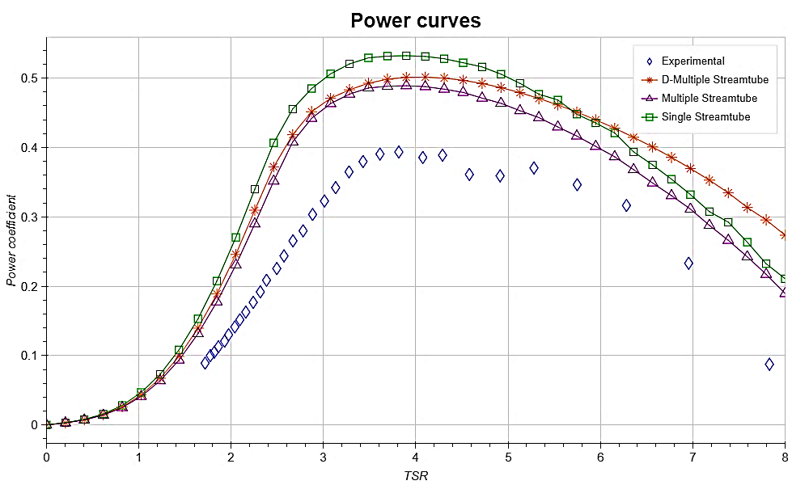

4. RESULTS VALIDATION
Comparison with Experimental data
A. Shires and Andrew (2013) used data of this turbine in a work of Development and Evaluation of an Aerodynamic Model for Novel VAWT
VAWT Ltd 260H [9]
Rated power (kW) | 100
Rotational speed (rpm) | 33
Rated wind speed (m/s) | 10
Rotor diameter (m) | 19.5
Swept area (m²) | 260
Blade airfoil | 2 x NACA 0018
Blade chord (m) | 1.02
Solidity | 0.105
AR | 13
Power curves of VAWT Ltd 260H
Power curves of VAWT Ltd 260H with finite AR effect
Notes:
With this turbine, after integrating AR effect, DMST give the best agreement with experimental data. Although MST over predict the data, it also has the similar trend with experimental data and DMST

Slide 19


4. RESULTS VALIDATION
Comparison with Experimental data
A. Shires and Andrew (2013) used data of this turbine in a work of Development and Evaluation of an Aerodynamic Model for Novel VAWT
VAWT Ltd 850H [9]
Power curves of VAWT Ltd 850H
Rated power (kW) | 500
Rotational speed (rpm) | 13.6
Rated wind speed (m/s) | 13.5
Rotor diameter (m) | 35
Swept area (m²) | 850
Blade airfoil | 2 x NACA 0018
Blade chord (m) | 1.84
Solidity | 0.105
AR | 13.2
Power curves of VAWT Ltd 850H with finite AR effect

Slide 20



5. DESIGN APPLICATION
Prediction using 2 Multiple streamtube model
Input parameters of designing turbine
Design wind speed (m/s) | 6
Swept area (m²) | 5
Blade airfoil | 3 x NACA 0021
Rotor height (m) | 2.5
Rotor diameter (m) | 2
$$σ_{optimum}=0.15−0.2$$
$$TSR_{optimum}=3.4−2.8$$
Power curves prediction with Double Multiple Streamtube model
Notes:
For this operating regime, we will run the script for a range of TSR by varying blade chord as well as shifting up TSR of each running solidity go get one power curves. As a result, we will produce a number of power curves

Slide 21



5. DESIGN APPLICATION
Prediction using 2 Multiple streamtube model
Input parameters of designing turbine
Design wind speed (m/s) | 6
Swept area (m²) | 5
Blade airfoil | 3 x NACA 0021
Rotor height (m) | 2.5
Rotor diameter (m) | 2
$$σ_{optimum}=0.15−0.2$$
$$TSR_{optimum}=3.5−2.9$$
Power curves prediction with Multiple Streamtube model

Slide 22



5. DESIGN APPLICATION
Prediction using 2 Multiple streamtube model
Input parameters of designing turbine
Design wind speed (m/s) | 6
Swept area (m²) | 5
Blade airfoil | 3 x NACA 0021
Rotor height (m) | 2.5
Rotor diameter (m) | 2
$$σ_{op_{SST} }=0.15−0.2$$
$$TSR_{optimum}=3.4−2.6$$
Solidity graphs with different $C_{D}$ characteristic with finite AR effect

Slide 23

5. DESIGN APPLICATION
Prediction using 2 Multiple streamtube model
Input parameters of designing turbine
Design wind speed (m/s) | 6
Swept area (m²) | 5
Blade airfoil | 3 x NACA 0021
Rotor height (m) | 2.5
Rotor diameter (m) | 2
Suggested parameter | Multiple stream tube model | Double multiple stream tube model | SST with Betz’s limit
Solidity | $$0.15−0.2$$ | $$0.15−0.2$$ | $$0.15−0.2$$
TSR | $$3.5−2.9$$ | $$3.4−2.8$$ | $$3.4−2.6$$
$$C_{P}$$ | $$0.33$$ | $$0.32$$ | ----
Design wind speed (m/s) | 6
Swept area (m²) | 5
Blade airfoil | 3 x NACA 0021
Rotor height (m) | 2.5
Rotor diameter (m) | 2
Solidity | 0.15 – 0.2
Blade chord (m) | 0.1 – 0.13
TSR | 3.4 – 2.8
Rotational speed (rpm) | 189 – 166

Slide 24






5. DESIGN APPLICATION
Effect of pitching angle
Angle of attack
$$α=φ+β$$
$$φ=\operatorname{atan}{\frac{\frac{V}{V_{∞}}\cos{θ}}{TSR−\frac{V}{V_{∞}}sinθ}}$$
Blade pitch angle’s sign convention ( [10])
Turbine parameters
Design wind speed (m/s) |  | 6
Swept area (m²) |  | 5
Blade airfoil |  | 3 x NACA 0021
Rotor height (m) |  | 2.5
Rotor diameter (m) |  | 2
Solidity |  | 0.2
Blade chord (m) |  | 0.13
TSR |  | 2.8 – 3.4
Blade pitch angle ($°$) |  | $$[−4,+4]$$
Normal and tangential force coefficients
$$C_{N}=C_{L}\cos{φ}+C_{D}\sin{φ}$$
$$C_{T}=C_{L}\sin{φ}−C_{D}\cos{φ}$$
Notes:
[10] A. Rezaeiha, I. Kalkman, and B. Blocken, “Effect of pitch angle on power performance and aerodynamics of a vertical axis wind turbine,” Appl. Energy, vol. 197, pp. 132–150, Jul. 2017.

Slide 25










5. DESIGN APPLICATION
Effect of pitch angle
$$V_{∞}=6 m/s$$
$$V_{∞}=4 m/s$$
$$V_{∞}=4 m/s$$
$$V_{∞}=4 m/s$$
$$V_{∞}=8 m/s$$
$$V_{∞}=10 m/s$$

Slide 26
6. CONCLUSIONS
Achievements
Limitations
This thesis utilizes a straightforward and affordable approach to forecast the performance of VAWT by combining momentum theory with blade element method in three prevalent streamtube model.
Finite aspect ratio effect is also taken into effect to enhance prediction accuracy.
Beside the performance output, sub parameters of the turbine such as AOA, force coefficient, induction factor…could also available structure analysis.
Preset blade pitch angle effect is studied and shows power improvement
There only one secondary effect integrated into the model
The thesis doesn’t have an alternative prediction model apart from streamtube models, so that there is no comparison between different kind of prediction model
All the calculation process and stages are written in scripts of code so that it is require the user to have a specific amount of knowledge of coding and VAWT in order to utilize them
Tangential force is still need more improvement
Power coefficients still have huge discrepancies in high TSR region

Slide 27
REFERENCES
[1] I. Paraschivoiu, Wind Turbine Design with empasis on Darrieus Concept. Polytechnic International Press, 2002.
[2] M. A. Biadgo, A. Simonović, D. Komarov, and S. Stupar, “Numerical and analytical investigation of vertical axis wind turbine,” FME Trans., vol. 41, no. 1, pp. 49–58
[3] J. F. Manwell, J. G. McGowan, and A. L. Rogers, Wind Energy Explained. 2009.
[4] E. Dyachuk, “Aerodynamics of Vertical Axis Wind Turbines - Development of Simulation Tools and Experiments,” Acta Universitatis Upsaliensis, 2015.
[5] L. H. Trong, “Development Of A Program For Designing Vertical Axis Wind Turbines,” Vietnam National University Ho Chi Minh City University Of Technology, 2016.
[6] M. A. Biadgo, A. Simonović, D. Komarov, and S. Stupar, “Numerical and analytical investigation of vertical axis wind turbine,” FME Trans., vol. 41, no. 1, pp. 49–58.
[7] A. Rezaeiha, I. Kalkman, and B. Blocken, “Effect of pitch angle on power performance and aerodynamics of a vertical axis wind turbine,” Appl. Energy, vol. 197, pp. 132–150, Jul. 2017.
[8] J. Kjellin, F. Bülow, S. Eriksson, P. Deglaire, M. Leijon, and H. Bernhoff, “Power coefficient measurement on a 12 kW straight bladed vertical axis wind turbine,” Renew. Energy, vol. 36, no. 11, pp. 3050–3053, Nov. 2011.
[9] A. Shires and Andrew, “Development and Evaluation of an Aerodynamic Model for a Novel Vertical Axis Wind Turbine Concept,” Energies, vol. 6, no. 5, pp. 2501–2520, May 2013.
[10] A. Rezaeiha, I. Kalkman, and B. Blocken, “Effect of pitch angle on power performance and aerodynamics of a vertical axis wind turbine,” Appl. Energy, vol. 197, pp. 132–150, Jul. 2017.

Slide 28
THANK YOU

Slide 29





4. DESIGN APPLICATION
Prediction using Single streamtube with Betz limit
Blade element lift coefficient | $$C_{L}=2π\sin{α}$$
Blade element drag coefficient | $$C_{D}=kC_{L}$$
$k$ | $$0.03$$
Induced factor $a$ | $$1/3$$
Professor N.T.Tong in his lectures of Wind turbine course, suggest that from Betz’s limit, maximum power coefficient occur at induced factor $a=1/3$.
$$σ_{op}=\frac{8/9}{\frac{1}{2π}{\left(\frac{W}{V_{∞}}\right)}^{2}\int_{0}^{2π}{C_{Ti}}dθ}$$
$$C_{P}=\frac{σ_{op}}{2π}{\left(\frac{W}{V_{∞}}\right)}^{3}\int_{0}^{2π}{C_{P_{i}}dθ}$$
Induction factor $a$ in Betz’s limit at different azimutal positions.
Notes:
For the sake of simplicity, airfoil characteristic as well as Reynolds number is left out.

Slide 30






5. DESIGN APPLICATION
Prediction using Single streamtube with Betz limit
$C_{p}$ curves with different $C_{D}$ chacteristic
Solidity graphs wth different $C_{D}$ chacteristic
$$TSR_{optimum}=3.8−2.8$$
$$σ_{op_{SST} }=0.11−0.16$$

Slide 31


Slide 32

4. RESULTS VALIDATION
Comparison with Numerical simulation
In a paper about Numerical Investigation of VAWT from University of Belgrade[6], authors also use Double Streamtube Model to predict the power curves of a turbine
Turbine parameters [6]
Rated wind speed (m/s) | 5
Rotor diameter (m) | 4
Rotor height (m) | 4
Swept area (m²) | 16
Blade airfoil | 3 x NACA 0012
Blade chord (m) | 0.2
Solidity | 0.15
Power curves from reference data with thesis calculation with 2 model
It is evident that from 2 to 3.2 of TSR, both model of this thesis under predict power coefficient. DMST prediction agree better than MST with reference data, which is understandable because these two set of data use the same DMST to predict. Nevertheless, DMST and MST both give a very similar trend of the power curve with reference data
Notes:
[6] M. A. Biadgo, A. Simonović, D. Komarov, and S. Stupar, “Numerical and analytical investigation of vertical axis wind turbine,” FME Trans., vol. 41, no. 1, pp. 49–58.

Slide 33









$$Rω$$
$$V$$
$$V_{∞}$$
$$W$$
$$θ$$
$$Vsinθ$$
$$Vcosθ$$
$$θ$$

